Slide 1
Demystifying the Pre-Conference Agenda Sharing (PCAS) Process
February 21, 2026
Virtual Service Information Day
Part 1, Lori M, DCM D74

Slide 2
We (Lori, Amanda, Bill) will be covering:
Part 1, Lori:
Overview of PCAS in Area 83: purpose, history, place within General Service Conference
How PCAS supports informed group conscience and participation in AA's service structure
Part 2, Amanda:
GSR Focus, Why PCAS matters
Part 3, Bill:
Common Pitfalls and Real-world Challenges

Slide 3
To understand a topic better, I like to Define, Deconstruct, Reassemble
Pre: "before". (self-explanatory)
Conference: General Service Conference
Agenda: What gets discussed
Sharing Process: the "How"
ie: Let's get together and discuss what will be talked about in New York City at the General Service Conference this Spring, and add our 2 cents worth.

Slide 4

History: Let's get back to Bill W. and Dr Bob

Slide 5
CONTEXT: re "Conference": Some important dates in AA
1934-1935: Bill W., a hopeless alcoholic, has a spiritual experience and gets sober. Bill and Dr. Bob meet in Akron Ohio. Dr. Bob has last drink and ...AA founded June 10, 1935
1938: 12 Steps written
1938: The Alcoholic Foundation is established, a trusteeship
1939: "Alcoholics Anonymous," is published

Slide 6
Conference (continued)
By 1950 founders are aging and decide to try reorganizing so the membership is in charge...
But how?

Slide 7
Let's turn this upside down! Start with:
AA members
Groups, places
Bill, Bob, Trustees, NYC

Slide 8
Bill W. and Dr. Bob:

Slide 9
Create this: (p107, the AA Service Manual)
AA groups
Group GSRs
Districts
Area Assemblies
General Service Conference
General Service Board, AAWS/AA Grapevine

Slide 10
So between 1951 and 1954 a trial of...
"General Service Conference" starts, linking Trustees of the Alcoholic Foundation...
THIS WORKS, and is adopted in 1954.
…with entire FELLOWSHIP.

Slide 11
Next:
Pre: "before"
Conference: General Service Conference
Agenda: What gets discussed
Sharing Process: the "How"

Slide 12
Path of an Item on the Agenda at Conference
Starts as an idea (Anyone's: member, group, delegate, area committee member, directors/staff member of AAWS and Grapevine)...submit by September
AA staff studies it in light of previous Conference actions, passes on to trustee's conference committee or the appropriate Conference committee to determine ...when...where...whether it will appear on the Conference agenda...finalize in February
Now we need to see what membership thinks!!... before April/May Conference. (Hence the short time-line)

Slide 13
Next..
Pre: "before"
Conference: General Service Conference
Agenda: What gets discussed
Sharing Process: the "How"
Let's get together and discuss what will be talked about in New York City this Spring, and add our 2 cents worth.

Slide 14

How?
Co-operatively!
Delegate receives the final agenda items and loads of background material
Calls upon area members (committee chairs, area officers, past delegates) to summarize this large amount of material in a way that is easy to pass on to all members
DCMs bring this to Districts, GSRs bring it to groups, discussions are held, ideas are circulated.

Slide 15
So how do we pass on these ideas and thoughts?
Saturday March 28, 2026 we get together in Assembly rooms and online to look again at the background summary information and record our thoughts which are compiled and presented to the delegate. PCAS DAY
(Or we contact her (Amy L.) directly with our ideas.)
THEN she knows what we are thinking and what our group consciences are! And she can take this information to the Conference (so really, the membership runs the show).

Slide 16
Create this: (p107, the AA Service Manual)
AA groups
Group GSRs
Districts
Area Assemblies
General Service Conference
General Service Board, AAWS/AA Grapevine

Slide 17
Some general examples of decisions from Conference (originating with membership)
Expand our pamphlet and public information selections, and retire some dated ones
Try to reach more still-suffering alcoholics by using different languages and writing styles
Use the newer technologies and reach even more people
Make sure our financial reports are transparent
All in support of Recovery, Unity and Service, our 3 Legacies.

Slide 18
GSR Focus: Why PCAS Matters
The GSR is first a trusted carrier of information to the group — then a carrier of information from the group.

Slide 19
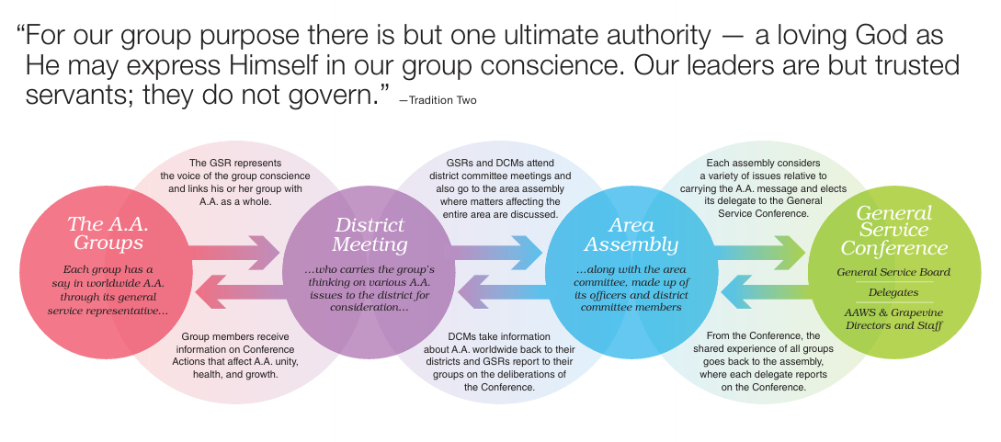

Slide 20
What is the role of the GSR in the PCAS process?
When we think about the GSR role at PCAS, most of us picture speaking at the microphone. But how much of the job actually happens before we ever get there?
The GSR role doesn’t start at the PCAS session — it starts in the home group.
Before we can carry the group’s voice out, we have to bring AA’s questions in.

Slide 21
The GSR is the group’s window into AA as a Whole and the General Service Conference
Group members don’t receive the background info directly. The GSR is how the material arrives.
For most group members, their GSR is how the Conference becomes 'real'.
As GSR, you can translate, inform, and invite participation.

Slide 22

Show of Hands
How many of you have ever brought PCAS material back to your group for discussion?

Slide 23

How do you inform your group (and not overwhelm them)?
Schedule time to discuss PCAS at your March business meeting.
Email the background information to your group members
Make yourself available to discuss and explain the PCAS process
Make it clear that ALL members of Area 83 are welcome to share at PCAS sessions – no service position required

Slide 24
Do you have to become an expert?
Never in the history of AA has anyone been asked to do that! You don't have to become an expert on the topics to bring the info to your group. You can explore it together.
People want to help! You can always reach out to other GSRs, your DCM, or the Area Committee Member who is chairing the PCAS session in question. They will be happy to help talk it through with you – they may even be available to attend your business meeting.

Slide 25
Show of Hands
Who has reached out to someone at a different service level for help?

Slide 26
What are you asking your group to do?
Not to fix AA
Not to vote on what the Conference should do
Not become experts on every topic
We’re asking something much simpler — and much more important. We’re asking them to help AA think.

Slide 27
PCAS – The Big Day
First and MOST IMPORTANT: These are not debates, they are sharing sessions.
Most of the time you’ll be listening. You’ll hear how other groups understood the question, what experiences they’ve had, and concerns you may not have considered.
When it’s your turn, your job is simple: briefly describe your group’s experience:
“Our group felt… Our group had concerns about… Our experience has been…”

Slide 28
Show of Hands
Who has attended a PCAS session before?
Who has gone up to speak at the microphone?

Slide 29

Rule 62 & The Joy of Being Useful
Enjoy the day! You are there to participate, there's no 'getting it right'. The day works because no one person is responsible for AA’s future.
We get to take part in is something AA has done for decades — trusting ordinary members to help shape our future together. How cool is that?
That shared responsibility often turns into shared joy & gratitude.

Slide 30


SERVICE INFORMATION DAY, FEBRIARY 21, 2026
PCAS: Pitfalls & Challenges
Bill C.
District Committee Member, District 06

Slide 31

The Ideal
You bring the information to your group and get:
robust feedback from everyone;
they send great emails to Amy L.

Slide 32
The Reality
The reality often looks nothing like the ideal.
But - Progress not Perfection
So, we will look at ways to make progress by looking at some common problems and pitfalls.

Slide 33

No One Answers
Email is overwhelmed with tumbleweeds
Business meeting is full of crickets.

Slide 34

Heavy Debate
One person at the business meeting wants to make sure their position is known... often... to everybody...

Slide 35
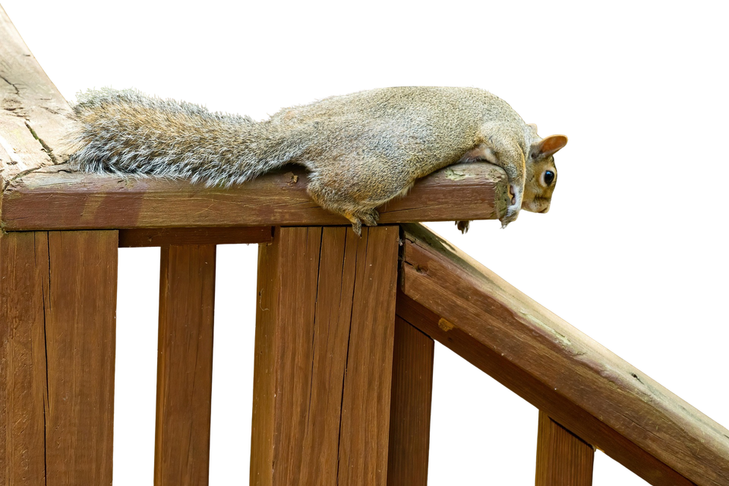
Why Should I Bother?
A member is discouraged because changes have been agreed upon at the GSC, such as the wording of the preamble, or the Plain Language Big Book.

Slide 36

Mass Confusion
You send out the information, but all you get back are questions about the materials and process.

Slide 37

QUESTIONS?

Slide 38

NO QUESTIONS!!
Ask-It Basket!!!

Slide 39


