Slide 1
Bringing the Traditions (and Concepts!) to your Business Meeting
(shared experience, strength, and hope from John W.)
Area 83 – Spring Assembly
March 28, 2026

Slide 2
Why are business meetings important?
Unity
Group conscience
Autonomy

Slide 3
Meeting basics:
Be prepared, send reminders, start on time
Have a printed/posted agenda that people can follow
Have printed/posted reports, minutes, etc.
Know your by-laws
Area 83 Operating Procedures
How the Conference operates
Understand the basics of Robert’s Rules of order

Slide 4
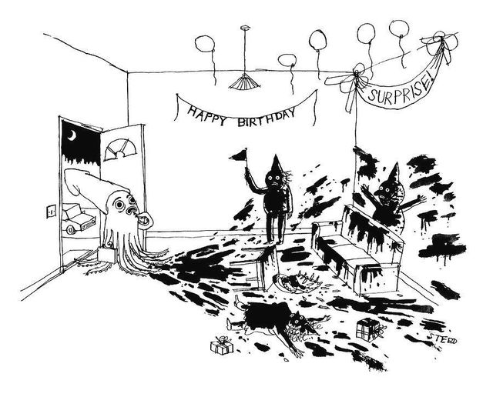
Nobody likes surprises...

Slide 5
Tradition One – Unity
Coming together to do the group’s business
Ensuring a healthy group
Start and end with either the Serenity Prayer or Responsibility Statement

Slide 6

Tradition Two – Group Conscience/Humility
Seeking an “informed” group conscience
Ensuring everyone is heard
Speed to completion is not the goal
Simple majority or substantial unanimity?

Slide 7
Tradition Four – Autonomy
Tradition Three – Membership
Does everyone in attendance get to vote? If not, be clear from the start.
Does this matter affect other groups or AA as a whole?
This is not a ‘get out of jail free’ card

Slide 8
Tradition Five – Primary Purpose
Are we discussing the right things?
Tradition Six – Non-affiliation
Be mindful of your relationship with your landlord

Slide 9

Tradition Seven – Self-support
Separate collections for parties/anniversaries
Spending 7th tradition collections wisely

Slide 10
Tradition Nine – Rotation
“Rotating Leadership is Best”
Are there term limits or sobriety requirements?
Leaving a position unfilled

Slide 11
Tradition Ten - Avoiding Outside issues and Controversies
Be mindful of your background and/or avatar when participating virtually
Be mindful of t-shirt slogans and buttons when in person

Slide 12

Tradition Twelve – Principles before Personalities
Do some members’ voices or opinions carry more weight?
Newcomers can be right and old-timers can be wrong

Slide 13
Concept Three – Right of Decision
Do we let trusted servants do their jobs?
Do we debate what size coffee cups to get or which brand of cookies to buy?

Slide 14

Concept Four –
Right of Participation
An obligation to attend my home group’s business meetings
Do I have a voice even if I don’t have a vote?
Abstaining

Slide 15
Concept Five – Right of Appeal
Minority Opinion – how it works
Reconsidering decisions

Slide 16

Concept Nine –
Good Leadership
Do we choose our trusted servants with care?
Sobriety requirements
Am I setting a good example as a trusted servant and/or elder statesman

Slide 17

Concept Ten - Authority/Responsibility
Importance of fulfilling my service position

Slide 18
Concept Twelve – The Warranties – AA’s Bill of Rights
We never become the seat of perilous wealth or power;
Sufficient operating funds and reserve be our prudent financial principle;
We place none of our members in a position of unqualified authority over others;

Slide 19
Concept Twelve – The Warranties – AA’s Bill of Rights
(cont.)
We reach all important decisions by discussion, vote, and, whenever possible, by substantial unanimity;
Our actions never be personally punitive nor an incitement to public controversy;
We never perform acts of government and we always remain democratic in thought and action.

Slide 20

Nota bene - Group Inventories and Sharing Sessions are great tools for helping groups through sticky items and issues (and resentments!) that linger unresolved

