Slide 1

Technology and Carrying the Message in A.A.
Robb w. – panel 61 delegate, area 83

Slide 2
From the Service Manual…
The General Service Representative, or GSR, is the link between the group and “A.A. as a whole.” This link becomes a channel through which news, information, opinions and ideas can flow back and forth. Importantly, this also gives the group a voice in the affairs of the Fellowship. The GSR is that voice.
The District Committee Member, or DCM, plays a vital role in general service. While the GSR is the voice of a group, the DCM is the voice of a district.

Slide 3
What it means to be a GSR…
The role of the general service representative, or GSR, is essential to the purpose of general service.
Bill W. wrote in Concept I of The Twelve Concepts for World Service: “The A.A. groups today hold ultimate responsibility and final authority for our world services.” The role of the GSR is essential to ensuring that groups can fulfill that responsibility. Only when a GSR keeps the group informed and communicates the group conscience can the Conference truly act for A.A. as a whole. This communication is a two-way street, making the GSR responsible not only for bringing forward the group’s voice, but for taking back to the group Conference actions that affect the Fellowship’s unity, health and growth.

Slide 4
From the 12 Concepts…
Final responsibility and ultimate authority for A.A. world services should always reside in the collective conscience of our whole Fellowship.
To insure effective leadership, we should endow each element of A.A. — the Conference, the General Service Board and its service corporations, staffs, committees, and executives — with a traditional “Right of Decision.”
Good service leadership at all levels is indispensable for our future functioning and safety. Primary world service leadership, once exercised by the founders, must necessarily be assumed by the trustees.

Slide 5

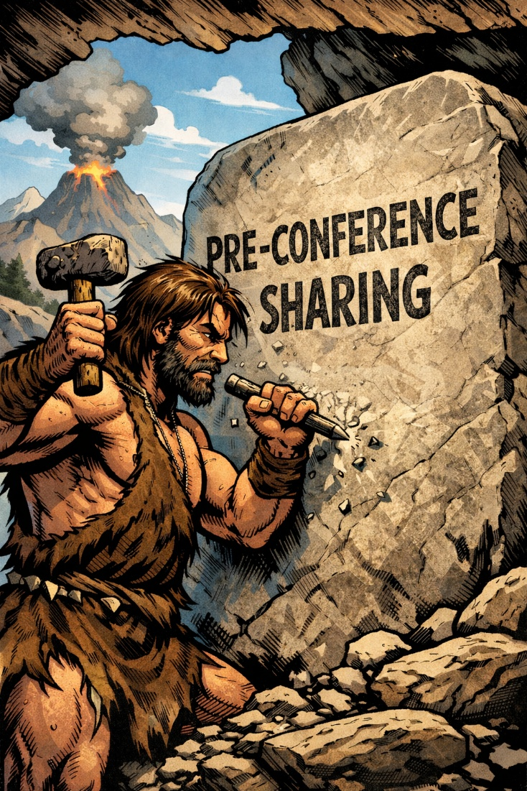

GSR & DCM Responsibility
Take notes
Take part
Ask questions
Report back to District, Groups
Bring feedback to the Delegate
Be aware

Slide 6
Information Flow
GSC
Delegate
Group
(GSR)
District
(DCM)
Area
GSR
DCM
GSR

Slide 7


Questions and Answers
I’ll give the questions…
You give the answers

Slide 8

How many here are GSR’s?

Slide 9
How many here are DCM’s?

Slide 10

How many GSR’s currently report back to your group at your business meeting?

Slide 11
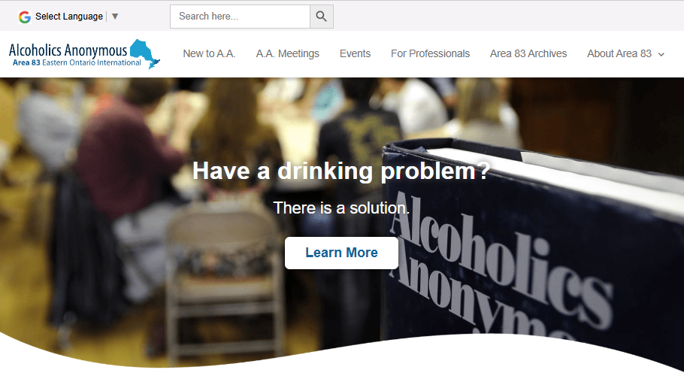
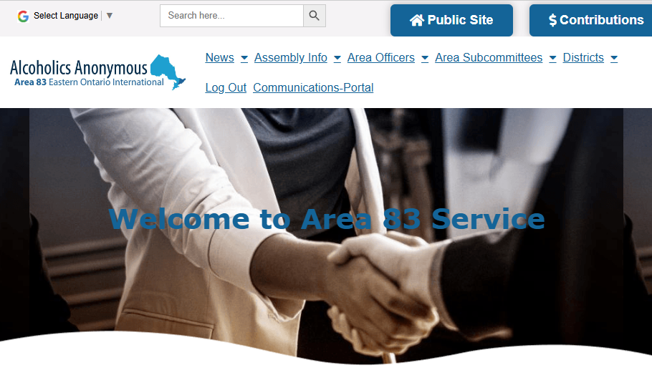
How many here are familiar with the Area Website?
Public
Service

Slide 12
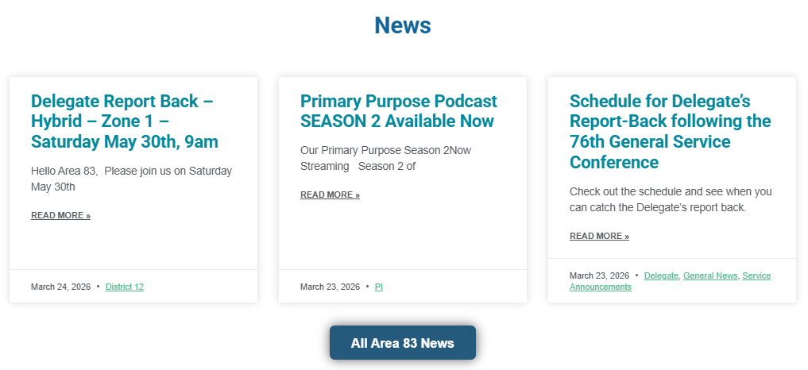
Service news on the website…

Slide 13
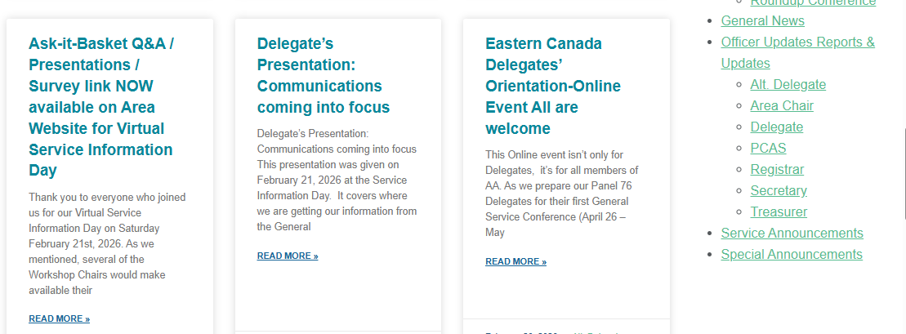
Service news on the website…
Filter by
Category!

Slide 14
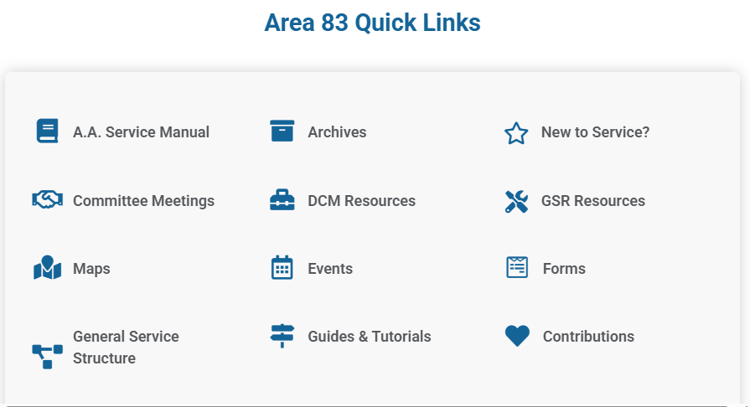
Service section of website…

Slide 15
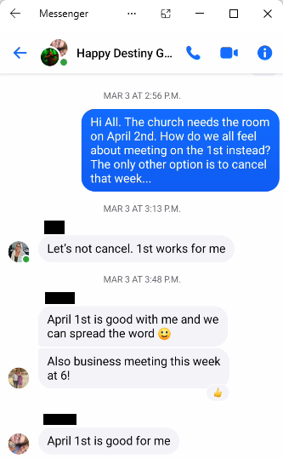
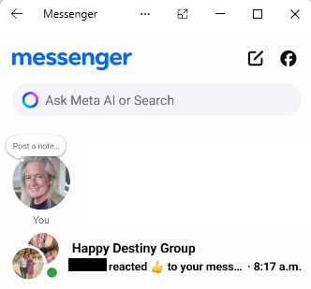
Other ways to communicate…
Great way to keep the Group informed as to what’s happening in General Service!
Group Member Chats

